Slide 1

UNIVERSITY INSTITUTE OF ENGINEERING
Bachelor of Engineering (Computer Science & Engineering)
Operating System (CST-328)
Subject Coordinator: Er. Puneet kaur(E6913)
DISCOVER . LEARN . EMPOWER

Slide 2
Lecture 6 CPU Scheduling
CPU Scheduling
Goals of Scheduling (objectives)
Preemptive Vs Nonpreemptive Scheduling
CPU Scheduling Algorithms
First-Come, First-Served (FCFS) Scheduling
Shortest-Job-Next (SJN) Scheduling
Priority Scheduling
Shortest Remaining Time
Round Robin(RR) Scheduling
Multiple-Level Queues Scheduling

Slide 3
CPU Scheduling
CPU scheduling is the basis of multi-programmed operating systems. By switching the CPU among processes, the operating system can make the computer more productive.
Scheduling is a fundamental operating-system function. Almost all computer resources are scheduled before use.

Slide 4
Context Switch
To give each process on a multi-programmed machine a fair share of the CPU, a hardware clock generates interrupts periodically. This allows the operating system to schedule all processes in main memory (using scheduling algorithm) to run on the CPU at equal intervals. Each switch of the CPU from one process to another is called a context switch.

Slide 5
CPU scheduling decisions may take place under the following four circumstances:
1. When a process switches from the running state to the waiting state (for. example, I/O request, or invocation of wait for the termination of one of the child processes).
2. When a process switches from the running state to the ready state (for example, when an interrupt occurs).
3. When a process switches from the waiting state to the ready state (for example, completion of I/O).
4. When a process terminates.

Slide 6
Criteria used for CPU scheduling algorithms are:
• CPU utilization.
• Throughput.
Arrival Time
Burst Time
• Turnaround time= Exit time - Arrival Time
• Waiting time.
• Response time.
Exit time

Slide 7
Goals of Scheduling
Fairness
Policy Enforcement
Efficiency
Response Time
Turnaround Time
Throughput

Slide 8
Preemptive/ Non-preemptive Scheduling
A scheduling discipline is non-preemptive if, once a process has been given the CPU, the CPU cannot be taken away from that process.
A scheduling discipline is preemptive if, once a process has been given the CPU, the CPU can be taken away.

Slide 9
CPU Scheduling Algorithms
First-Come, First-Served (FCFS) Scheduling
Shortest-Job-Next (SJN) Scheduling
Priority Scheduling
Shortest Remaining Time
Round Robin(RR) Scheduling
Multiple-Level Queues Scheduling

Slide 10
First Come First Serve (FCFS)
Jobs are executed on first come, first serve basis.
It is a non-preemptive scheduling algorithm.
Easy to understand and implement.
Its implementation is based on FIFO queue.
Poor in performance as average wait time is high.

Slide 11
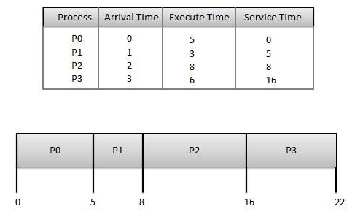
FCFS

Slide 12
Shortest Job Next (SJN)
This is also known as shortest job first, or SJF
This is a non-preemptive scheduling algorithm.
Best approach to minimize waiting time.
Easy to implement in Batch systems where required CPU time is known in advance.
Impossible to implement in interactive systems where required CPU time is not known.
The processer should know in advance how much time process will take.
Given: Table of processes, and their Arrival time, Execution time

Slide 13
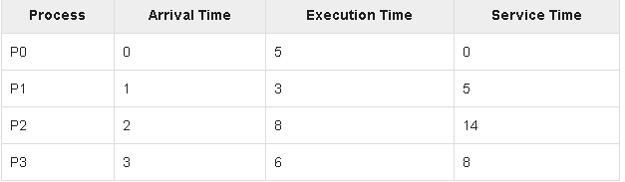
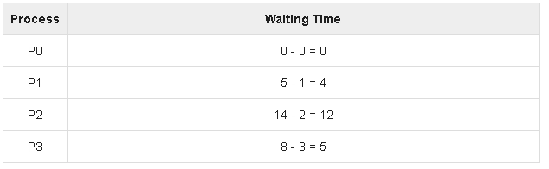
Shortest Job Next (SJN)

Slide 14
Priority Based Scheduling
Priority scheduling is a non-preemptive algorithm and one of the most common scheduling algorithms in batch systems.
Each process is assigned a priority. Process with highest priority is to be executed first and so on.
Processes with same priority are executed on first come first served basis.
Priority can be decided based on memory requirements, time requirements or any other resource requirement.

Slide 15
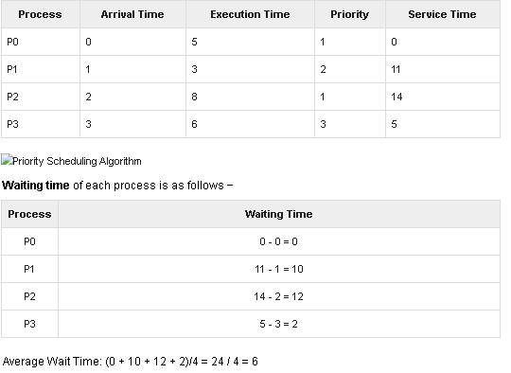
Priority Based Scheduling

Slide 16
Shortest Remaining Time
Shortest remaining time (SRT) is the preemptive version of the SJN algorithm.
The processor is allocated to the job closest to completion but it can be preempted by a newer ready job with shorter time to completion.
Impossible to implement in interactive systems where required CPU time is not known.
It is often used in batch environments where short jobs need to give preference.

Slide 17
Round Robin Scheduling
Round Robin is the preemptive process scheduling algorithm.
Each process is provided a fix time to execute, it is called a quantum.
Once a process is executed for a given time period, it is preempted and other process executes for a given time period.
Context switching is used to save states of preempted processes.

Slide 18
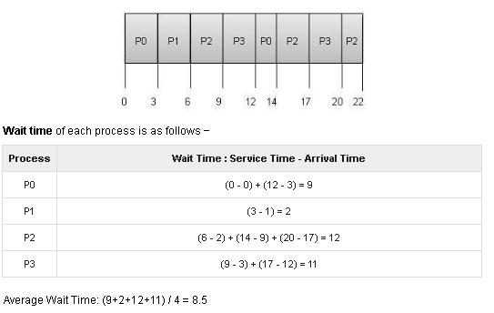
Round Robin Scheduling

Slide 19
Conclusion
Learning this topic will enable you to understand various types of CPU scheduling algorithm. To compare the performance of various Scheduling algorithms you need to implement these algorithms in OS Labs.

Slide 20
References
https://www.includehelp.com/c-programming-questions/
https://www.studytonight.com/operating-system/
https://computing.llnl.gov/tutorials/
https://www.tutorialspoint.com/operating_system/index.htm#:~:text=An%20operating%20system%20(OS)%20is,software%20in%20a%20computer%20system.
https://www.javatpoint.com/os-tutorial
https://www.guru99.com/operating-system-tutorial.html
https://www.geeksforgeeks.org/operating-systems/

